Slide 1
Asymptote
Gaurav Mishra
Ajaykumar Panchal
Neel Kudu
Tilak Bire

Slide 2
Problem statement
Life Time value analysis to know the peer of customers that should be targeted in order to generate the highest possible revenue. Also understand Cars type and Customer types that will help get highest revenue.
Geo-location based analysis in order to get insights about amount of revenue generated.
Perform the segmentation of customer in order to perform the targeted advertising to different peer of customers who will respond similarly to various stimuli by detecting underlying behaviour patterns

Slide 3
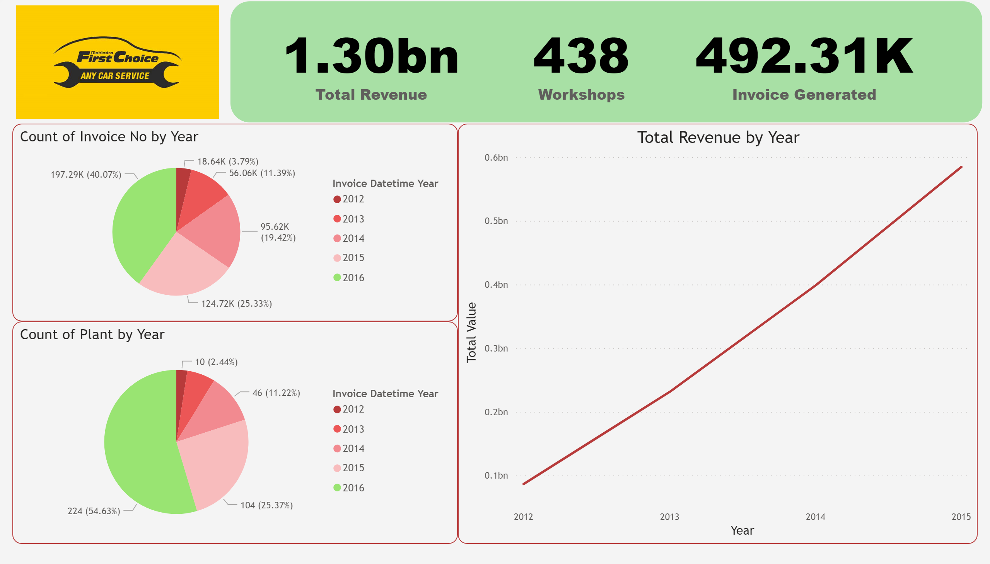

Slide 4
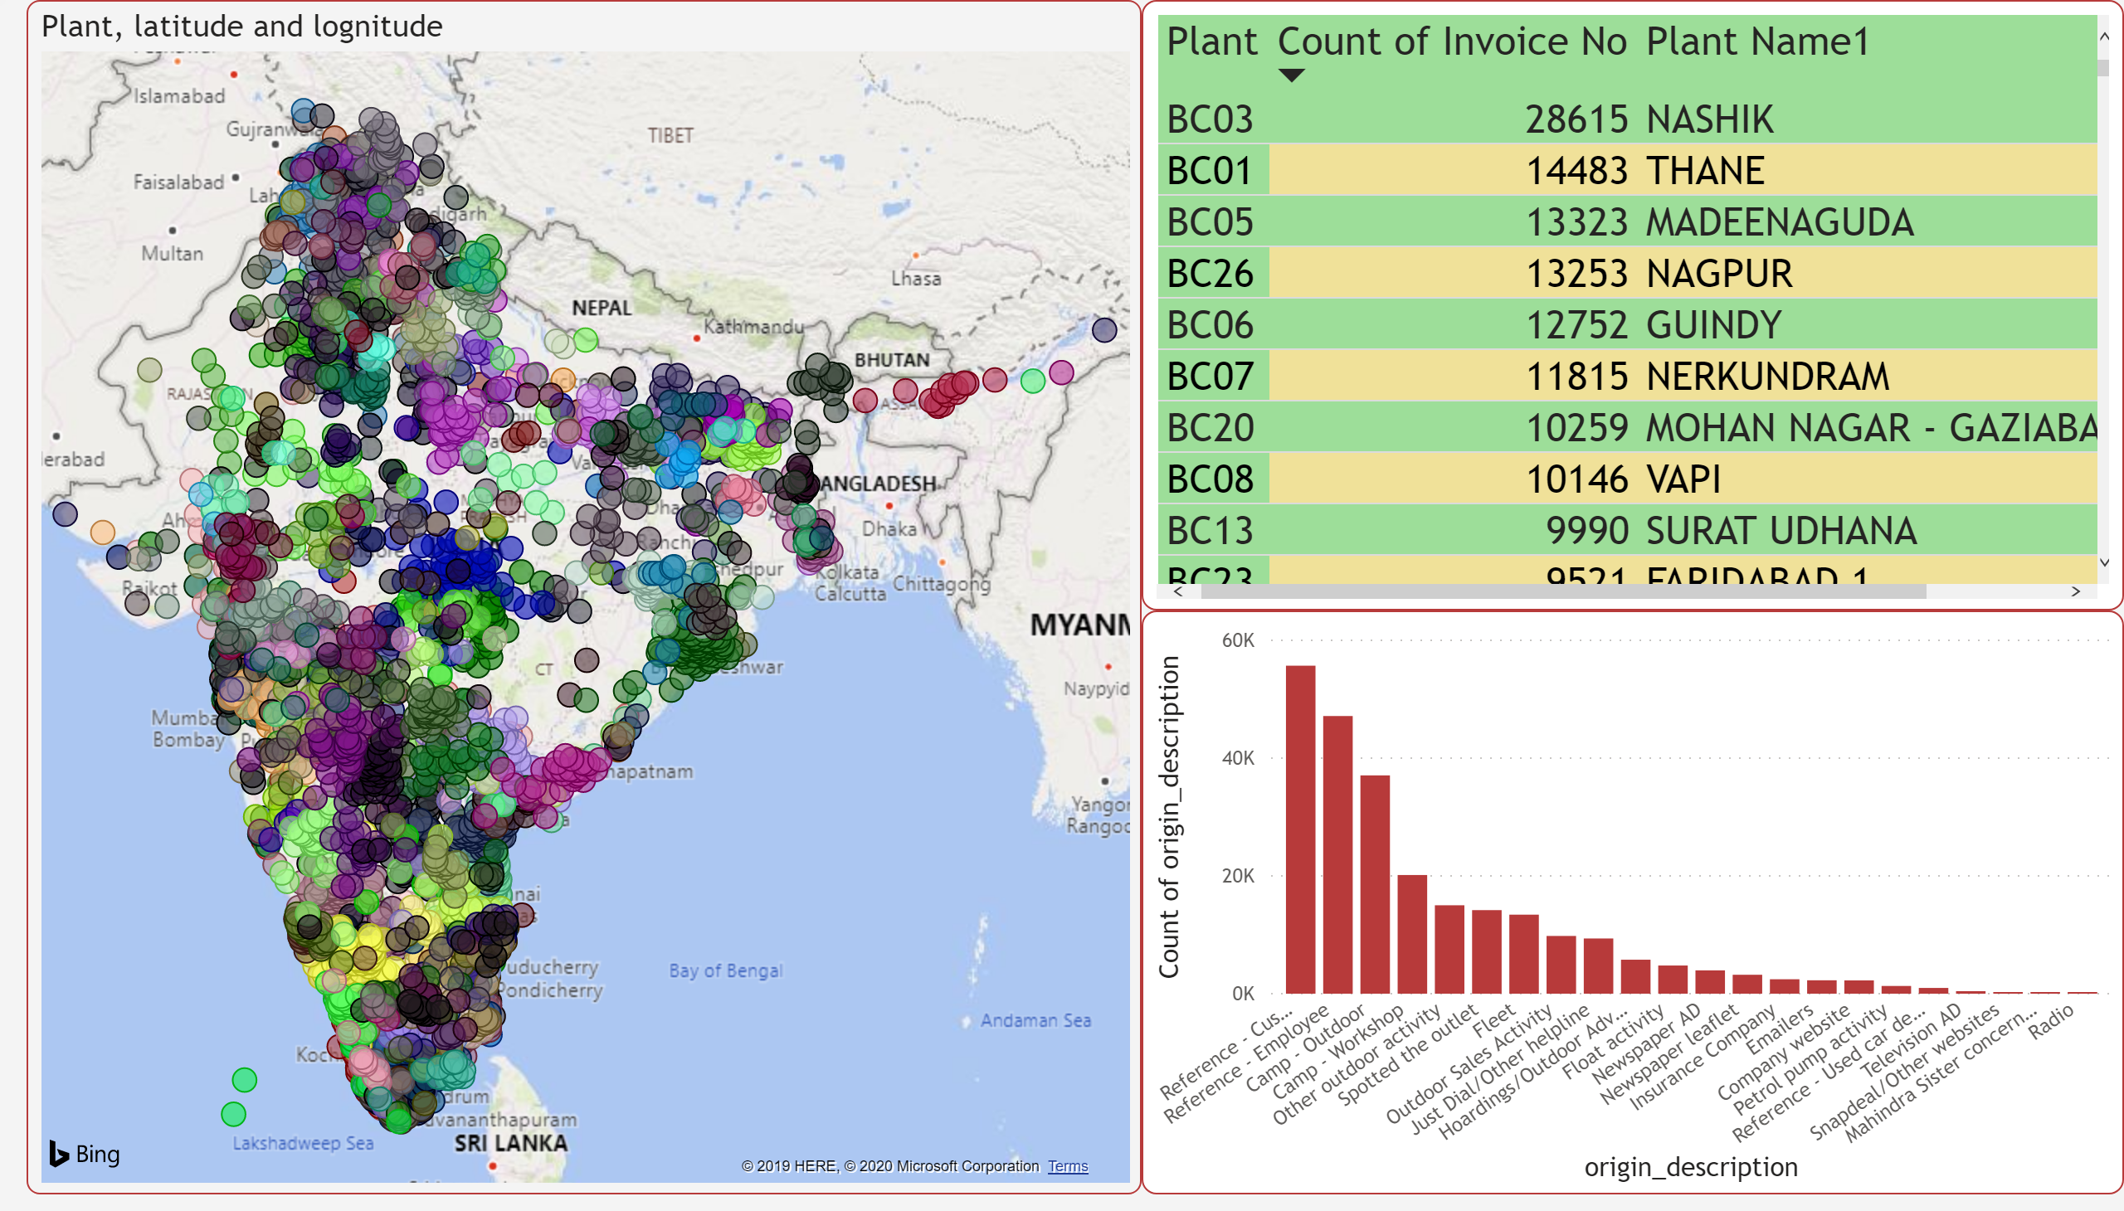

Slide 5
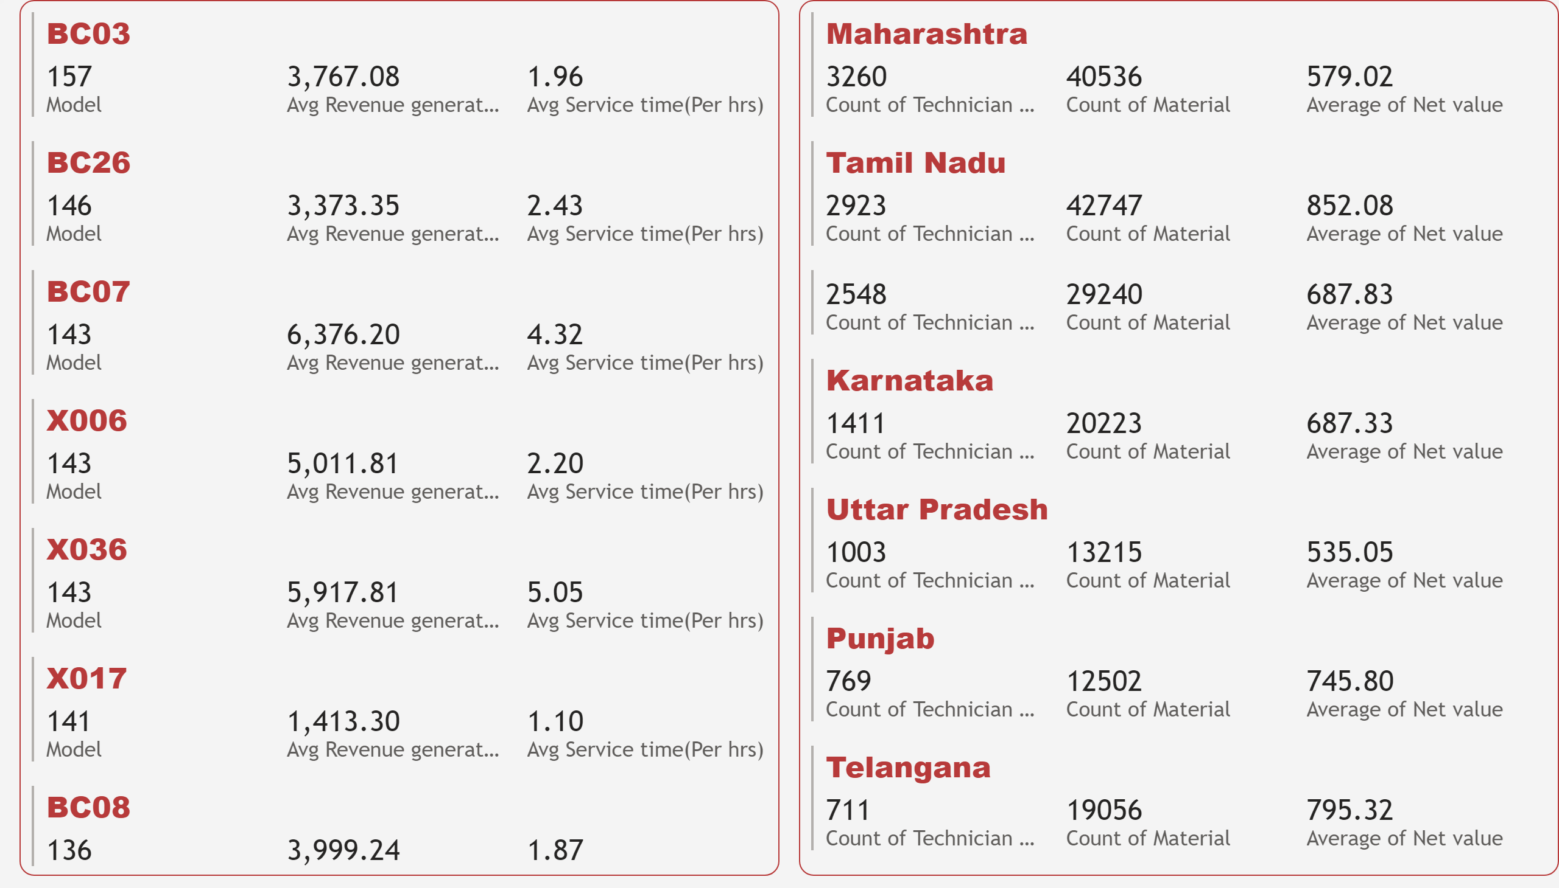

Slide 6
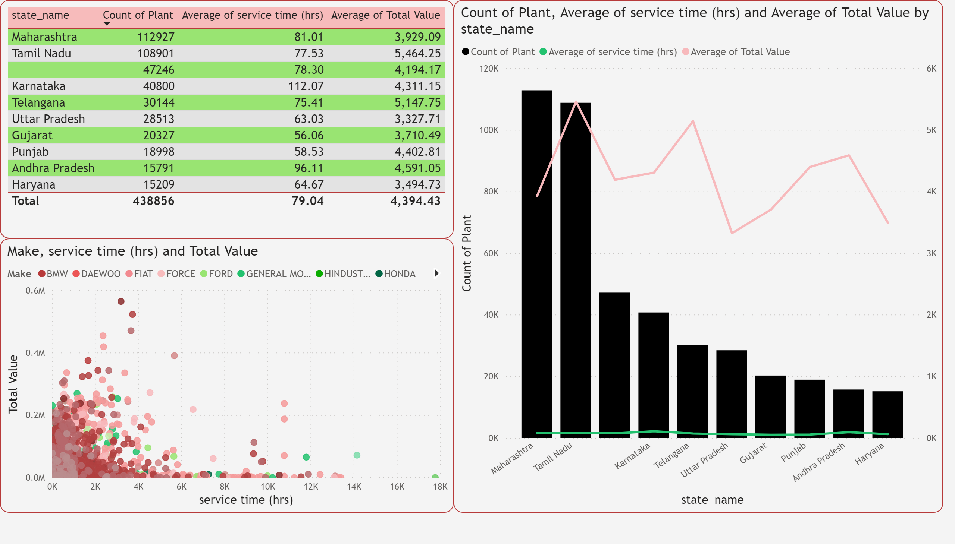

Slide 7
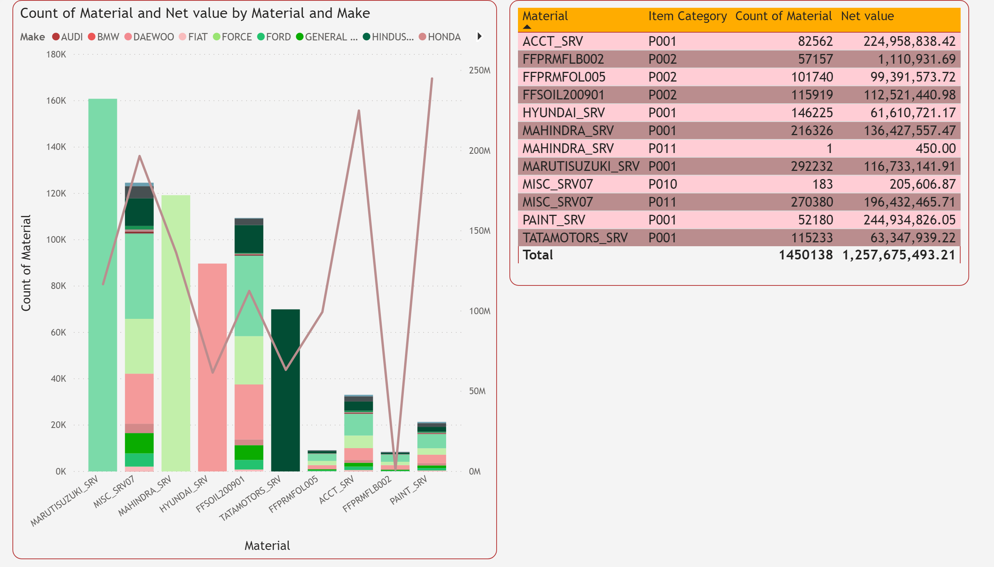

Slide 8
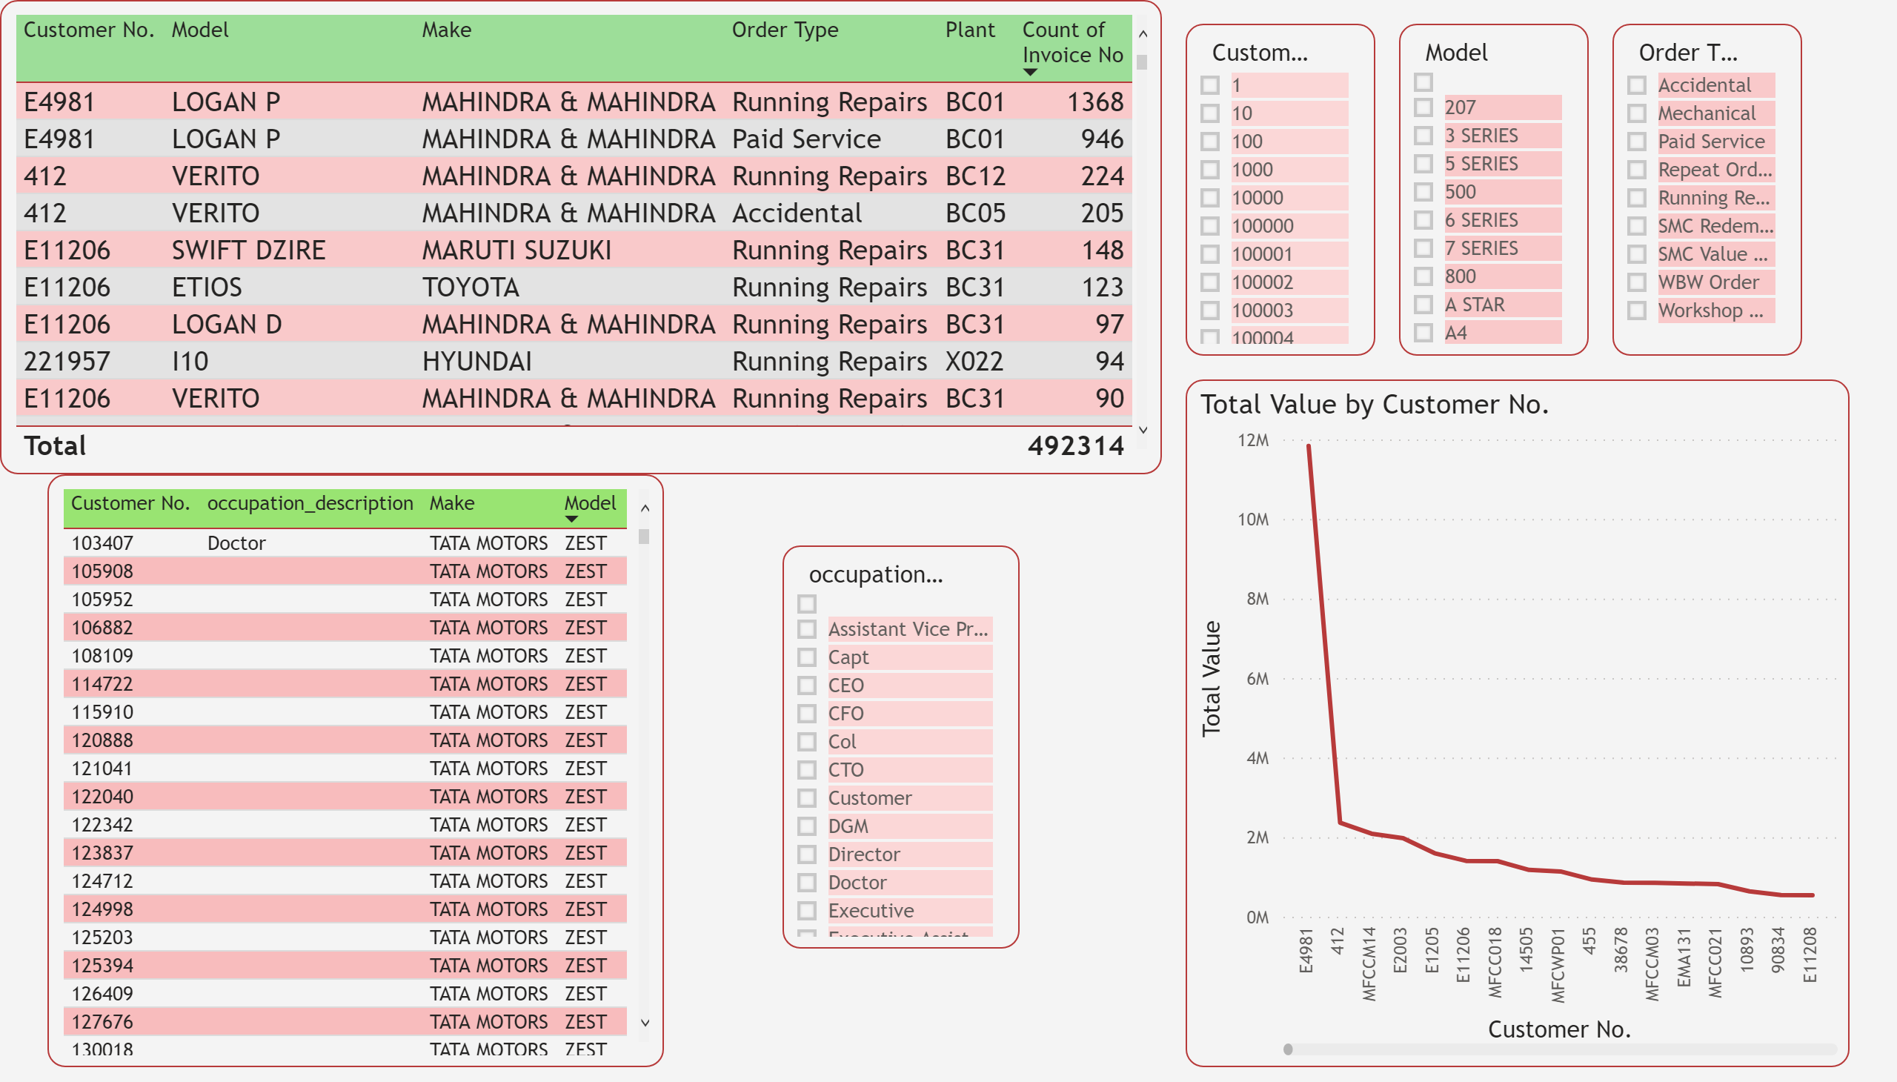

Slide 9
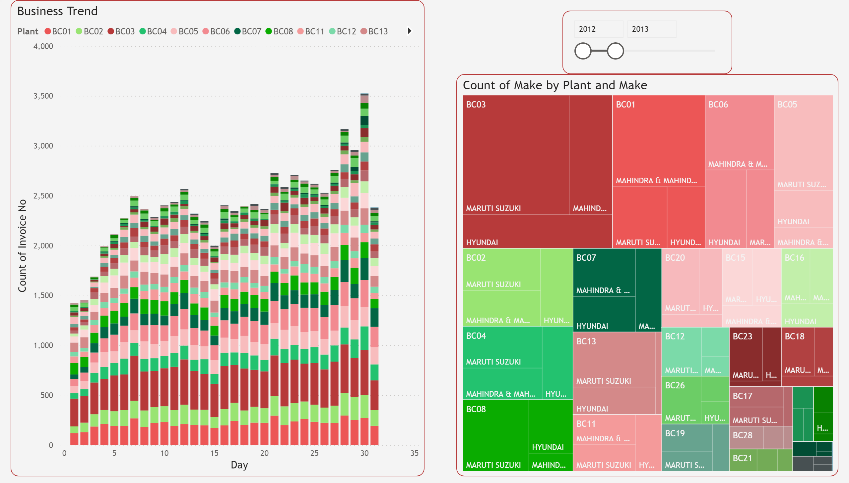

Slide 10
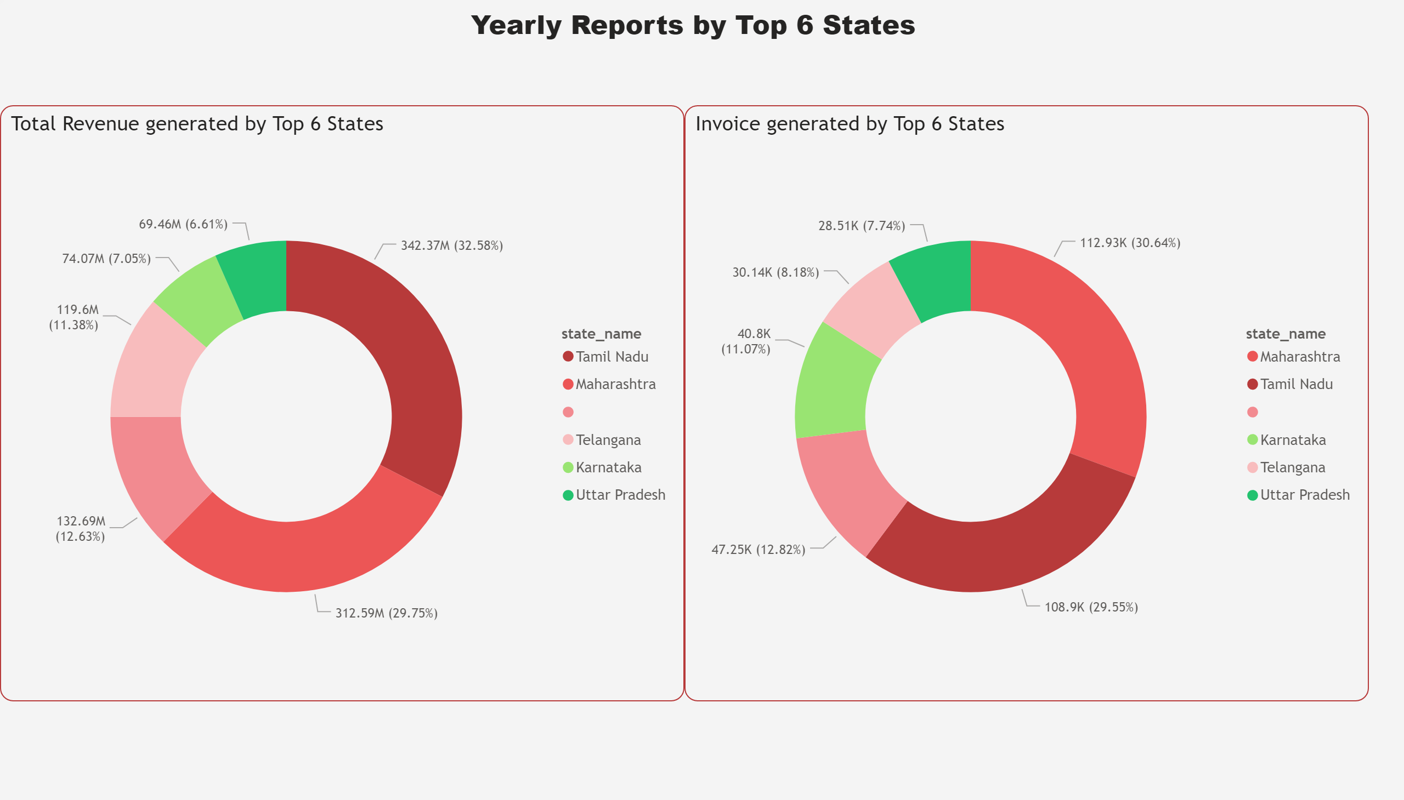

Slide 11
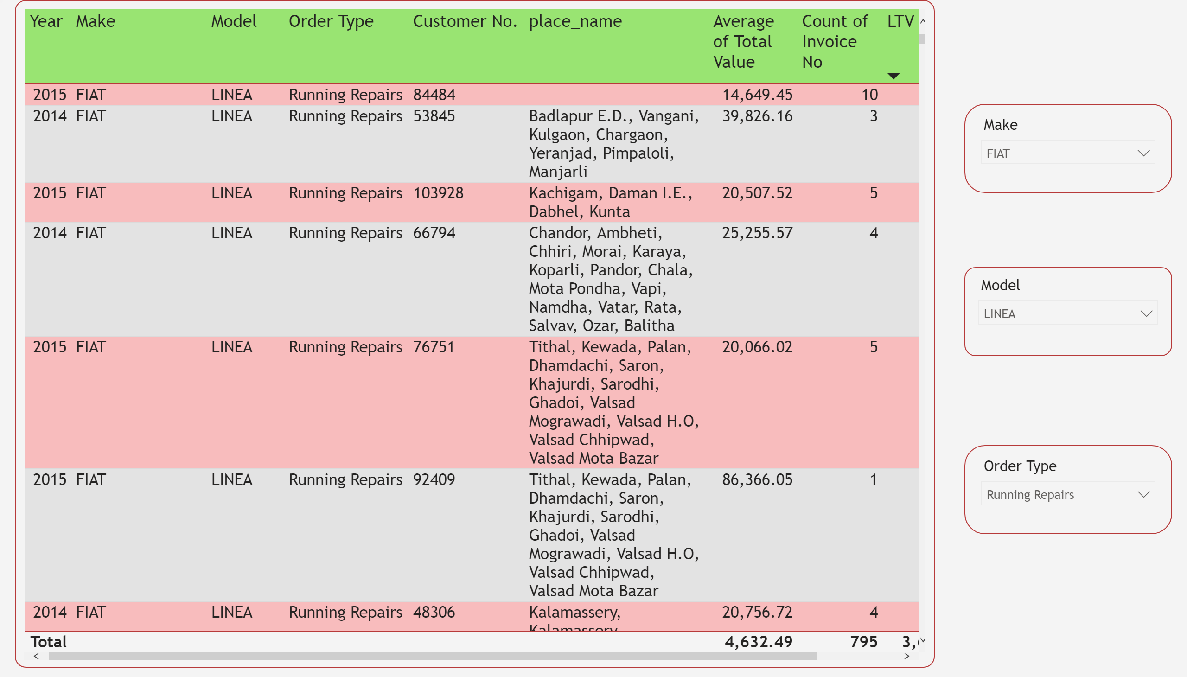

Slide 12
Customer life time value
Customer lifetime value is a metric that indicates the total revenue a business can reasonably expect from a single customer account.
It considers a customer's revenue value, and compares that number to the company's predicted customer lifespan.
Businesses use this metric to identify significant customer segments that are the most valuable to the company.

Slide 13
Calculation customer life time value
To calculate customer lifetime value you need to calculate average purchase value
Multiply that number by the average purchase frequency rate to determine customer value.
Then, once you calculate average customer lifespan, you can multiply that by customer value to determine customer lifetime value.

Slide 14
Productivity of a plant
Productivity of a Plant:
Calculate Number of Distinct Technicians present at the particular Plant
Calculate the total amount of service time in hours over a year
Calculate the total amount of revenue generated at the respective plant over a year
Productivity = Total Revenue(in year)/Total Service Time (in year) * Number of Technicians worked (in year)

Slide 15
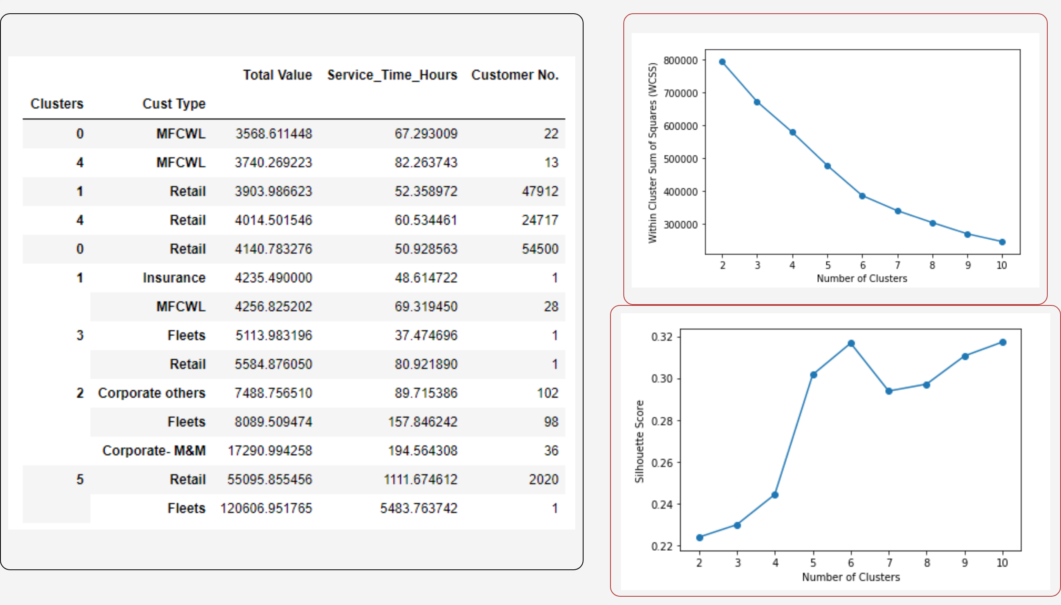

Slide 16
Suggestions
Take a feedback from the customer after service provided in order to improve the service in coming years.
Dataset has a inability to calculate the profit generated.
Enable cross selling of cars.
Spare parts are used most often.
Goal should be to target “Retail Type” customers.

